Slide 1


SYSTEM ARCHITECTURE
OF INSTAGRAM

Slide 2
UPLOAD PHOTOS VIEW UPLOADED PHOTO FOLLOW USERS VIEW FEEDS LIKE AND COMMENT ON PHOTOS
GENERAL FEATURES OF INSTAGRAM FOR THE USERS:

Slide 3
PER DAY USERS:
On an assumption:
1 billion active users per day
Media size(photo) assuming it as 100kb
So at min (1bn)/24*3600
On an average 1160 photos per second
SPACE REQUIRED PER DAY:
1bn * 100gb
And it has maintain the photos for a very long time assuming here as 10 years -> then our calculation looks like this
1bn * 100 * 365 *10gb

Slide 4
CAP THEOREM:
C: CONSISTENCY- EVENTUAL CONSISTENCY
A: AVAILABILITY- AVAILABLE TO ALL
P: PARTITION- WHICH MEANS SHARDING OF DATA
So Instagram opts for AP & for consistency it opts for eventual consistency

Slide 5
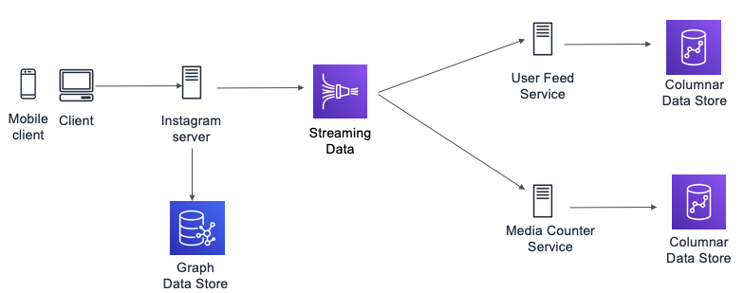
REQUIREMENTS FOR BUILDING IT:
TIME PERIOD OF AVAILABILITY OF PHOTOS (MANAGEMENT OF IMAGES) LATENCY IN NEWS FEED
CONSISTENCY (WITH THE HELP OF CAP THEOREM)
LATENCY OF NEWFEED(BEFORE IT WAS 100ms NOW REDUCED TO 10ms)

Slide 6
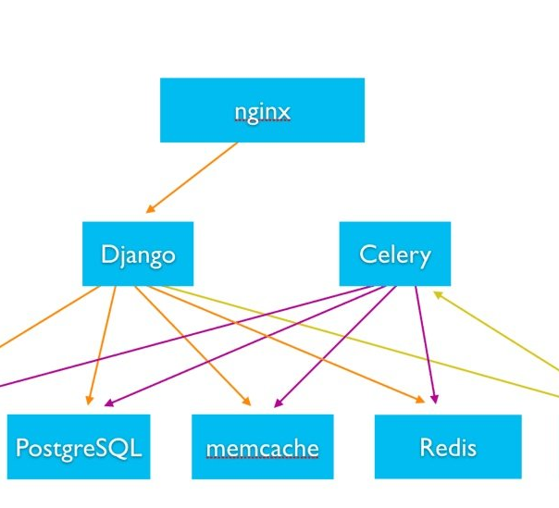
DATABASE USED
VARIOUS DATABASES ARE USED FOR VARIOUS PURPOSE:
STORE IMAGES
AGGREGATE DATA(CASSANDRA)
STORE THE ACTIVITY

Slide 7
DATABASE SIZE SCHEMA
NOSQL is preferred for Instagram photos
Key Value pair can be used (Key – PhotoID, Value- Respective Object)

Slide 8
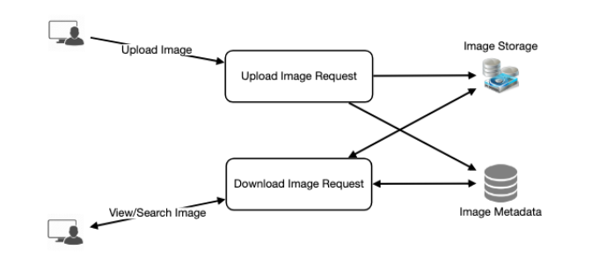
COMPONENT DESIGN
Usually there are more read operations than write ones
Hence separate DBS for read and write
Make use of Caching while read operation is performed

Slide 9
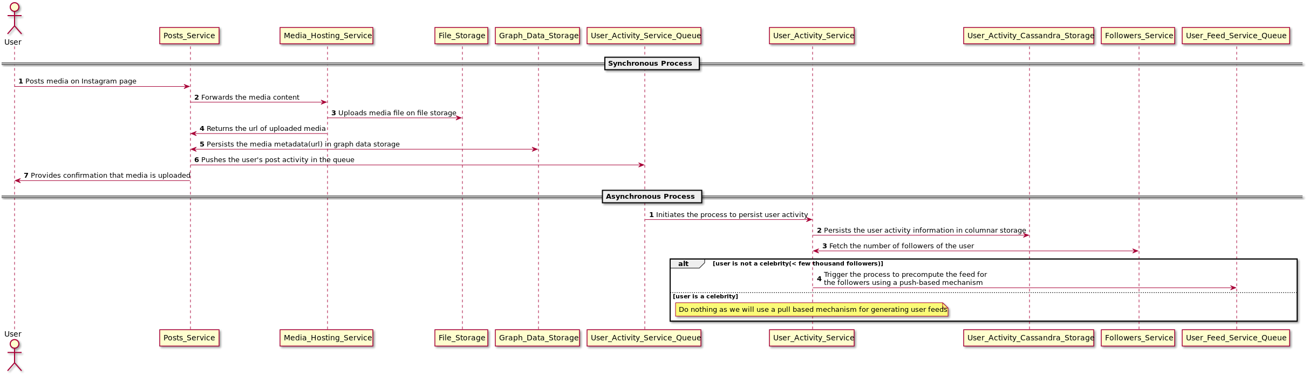
SEQUENTIAL DIAGRAM WHEN USER POSTS ANY MEDIA

Slide 10
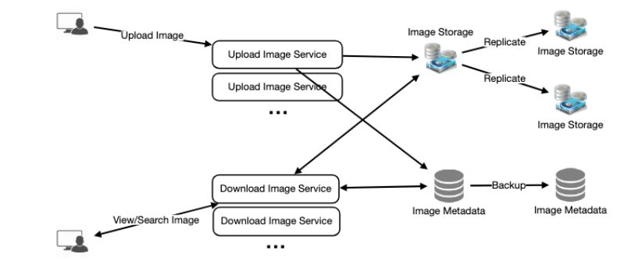
RELIABILITY & REDUNDANCY
Multiple duplicates of services can be made to run, so that if any of the services goes down the remaining services can be active and running
There by creating a backup as well as single point failure

Slide 11
NEWSFEED GENERATION
Minimum No of followers for a user is 0 followers
Maximum no of followers for a user right now is for Ronaldo which is approx around 219mn and growing
So based on the activity of the followers these feeds are generated
OPTIMIZING THE FEEDS:
Pre- calculate the feeds(delay in generating the media for the followers)
Batch Processing
Use of cache

Slide 12
DATA SHARDING
PARTITION BASED ON USERID: Having unique USERID and storing all the photos inside this UNIQUE id can create a problem when any of the services of the DB goes down, then the data of that particular USER will completely be down
PARTITION BASED ON PHOTOID: Having unique photoid instead of userid can solve the above problem

